Slide 1


Resting-State fMRI:
Principles and Data Analyses
严超赣
Chao-Gan Yan, Ph.D.
yancg@psych.ac.cn
http://rfmri.org/yan
Institute of Psychology, Chinese Academy of Sciences

Slide 2
Outline
Resting-State fMRI: Principles
Data Analysis: Computational Algorithms
Data Analysis: Methodological Issues
Data Analysis: Computational Platform
2

Slide 3
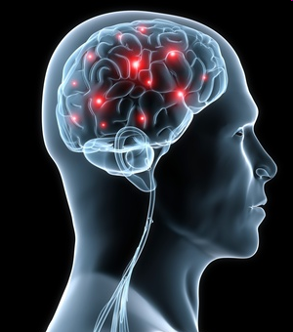
Resting-State fMRI: Principles
All of the human high mental functions such as thinking, emotion and consciousness rely on brain, an extremely complex system (Singer, 1999)
http://psychcentral.com/news/2010/11/03/new-insights-on-brains-internal-wiring/20500.html
3

Slide 4
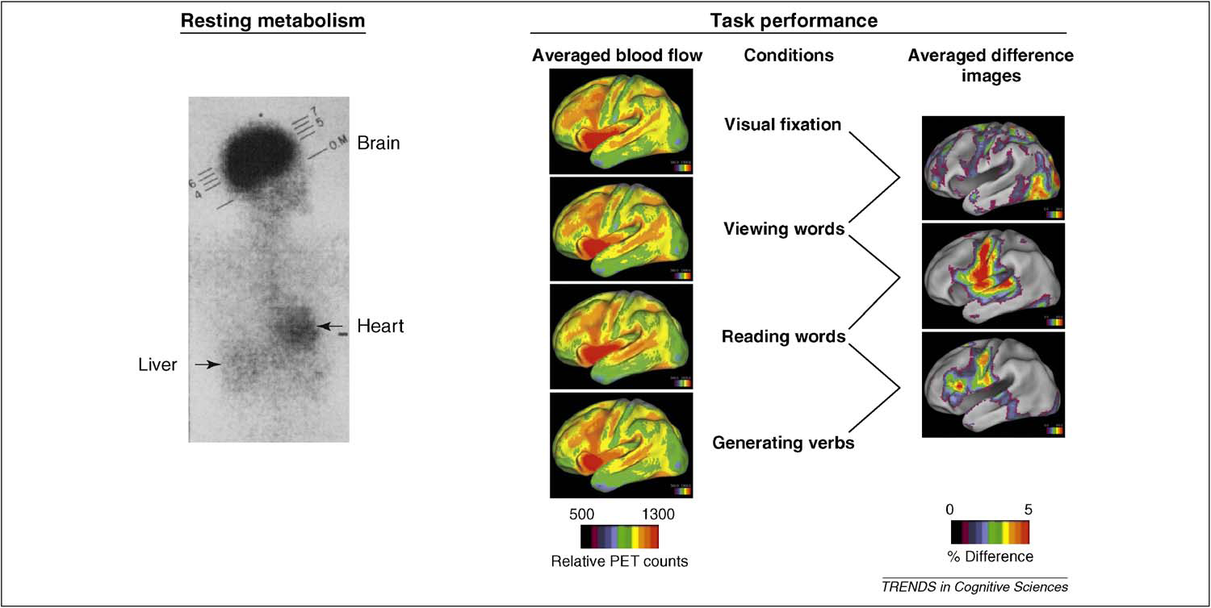

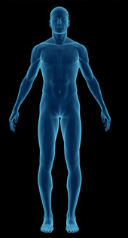
Resting-State fMRI: Principles
Weight
Cardiac output
Glucose consumption
2%
11%
20%
Raichle et al., 2010. Trends Cogn Sci
4

Slide 5
Resting-State fMRI: Principles
Task evoked increases
Resting-state energy consumption
<5%
There are very important activities in the brain during resting-state (Fox and Raichle, 2007; Zhang and Raichle, 2010)
Raichle et al., 2010. Trends Cogn Sci
5

Slide 6
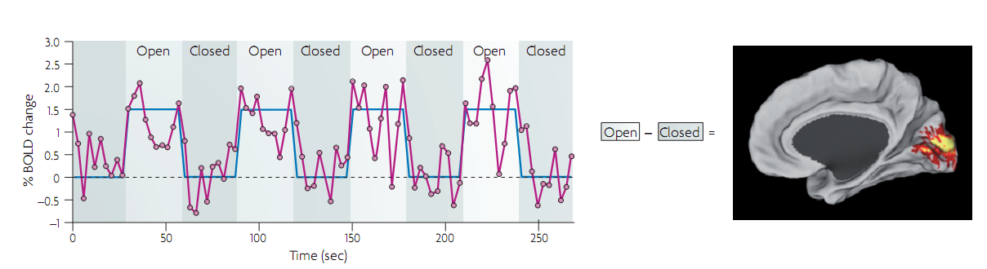
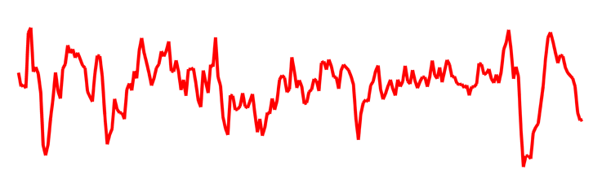
Resting-State fMRI: Principles
Task
Traditional fMRI analysis
Baseline
Noise?
Activities in the baseline state (usually resting-state)
Fox and Raichle, 2007. Nat Rev Neurosci
6

Slide 7
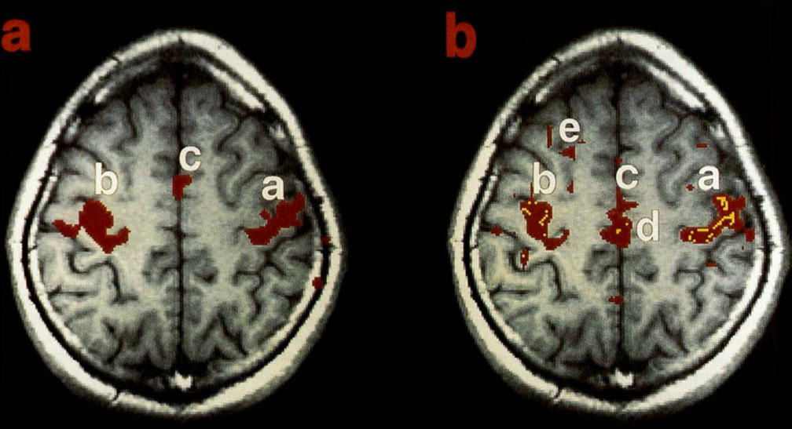
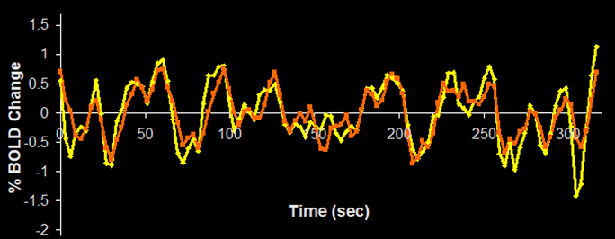
Resting-State fMRI: Principles
Temporal synchrony of spontaneous fluctuations
Task: left and right finger movement
Resting-state
Biswal et al., 1995. Magn Reson Med
7

Slide 8
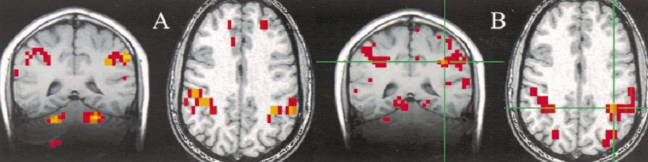
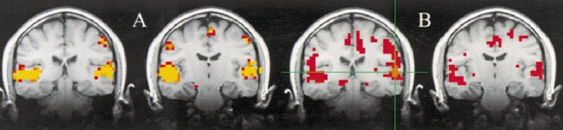
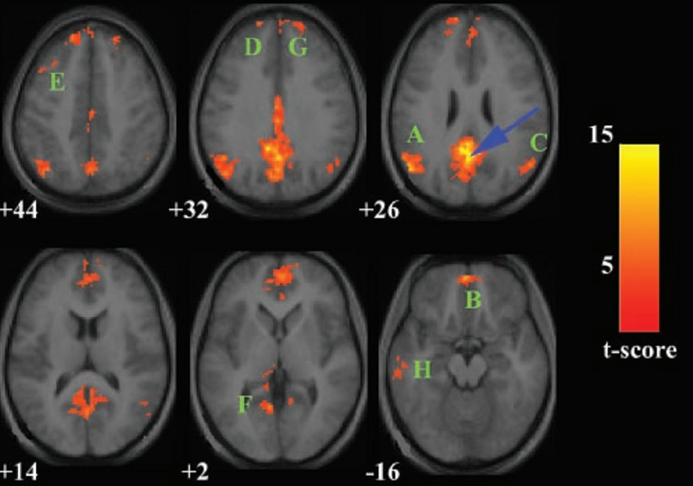
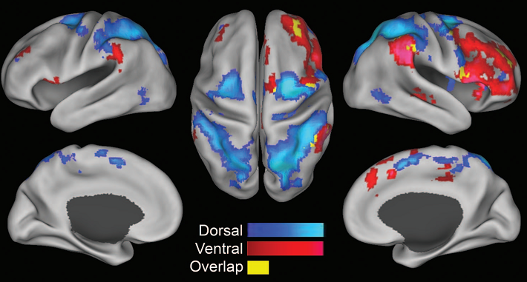
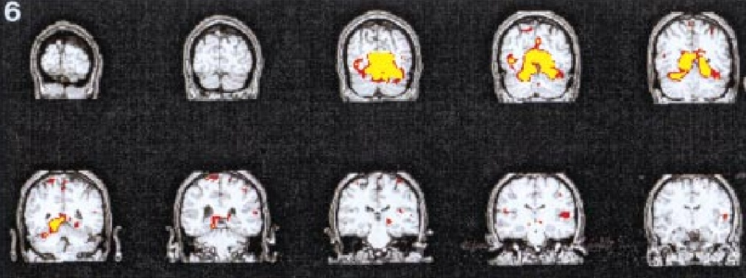
Resting-State fMRI: Principles
Functional networks identified by functional connectivity with resting-state fMRI (RS-fMRI)
Sensorimotor network (Cordes et al., 2000. AJNR)
Auditory network (Cordes et al., 2000. AJNR)
Visual network (Lowe et al., 1998. Neuroimage)
Attentional network (Fox et al., 2006. PNAS)
DMN (Greicius et al., 2003. PNAS)
8

Slide 9
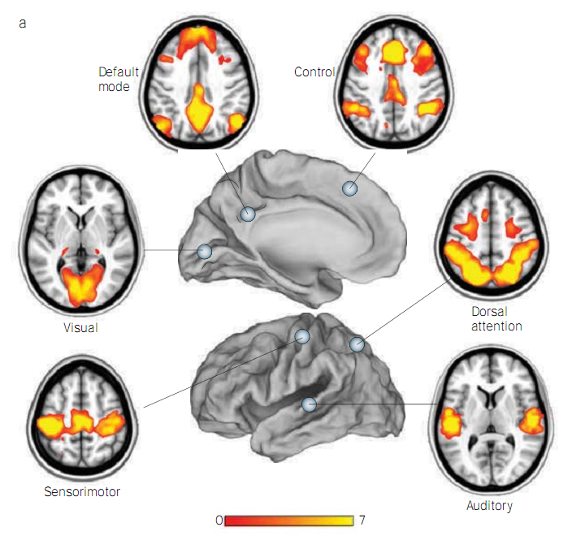
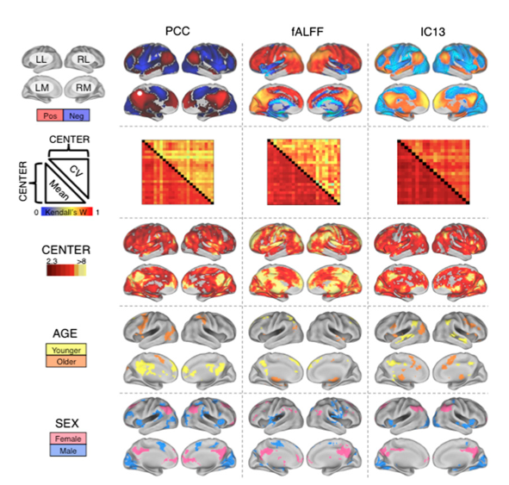
Resting-State fMRI: Principles
Zhang and Raichle, 2010. Nat Rev Neurol
Biswal et al., 2010. PNAS
9

Slide 10
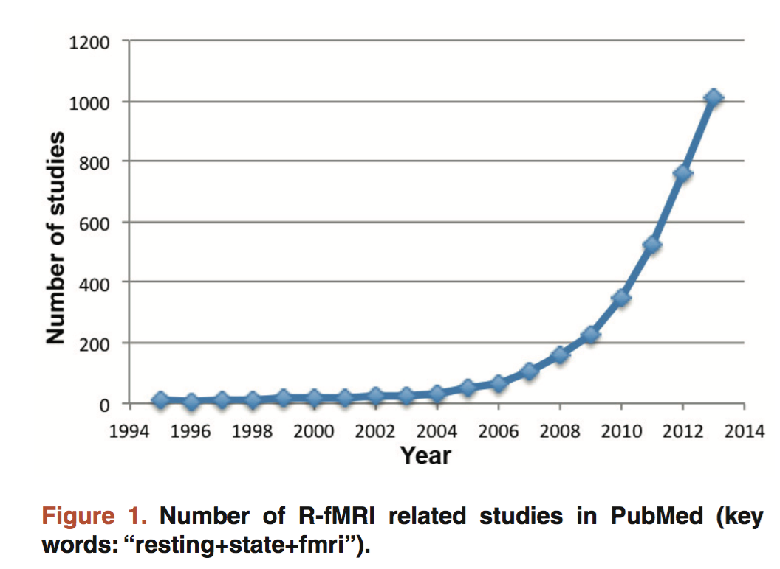
Resting-State fMRI: Principles
Yan et al., 2015. F1000Res

Slide 11
Outline
Resting-State fMRI: Principles
Data Analysis: Computational Algorithms
Data Analysis: Methodological Issues
Data Analysis: Computational Platform
11

Slide 12
Computational Methodology
Integration approach
Regional approach
Graphical approach

Slide 13
Computational Methodology
Integration approach
Functional Connectivity
Correlation: (Biswal et al., 1995; ……)
ICA: (Kiviniemi et al., 2003; van de Ven et al., 2004; Greicius et al., 2004)
Effective Connectivity: (Friston et al., 2002)
Hierarchical Clustering: (Cordes et al., 2000; Salvador et al., 2005)
Self Organization Map: (Peltier et al., 2003)
....

Slide 14
Computational Methodology
Correlation: Temporal synchrony of spontaneous fluctuations
Task: left and right finger movement
Resting-state
Biswal et al., 1995. Magn Reson Med
14

Slide 15
Computational Methodology
The “Resting” Brain
Courtesy of Dr. Daniel Margulies

Slide 16
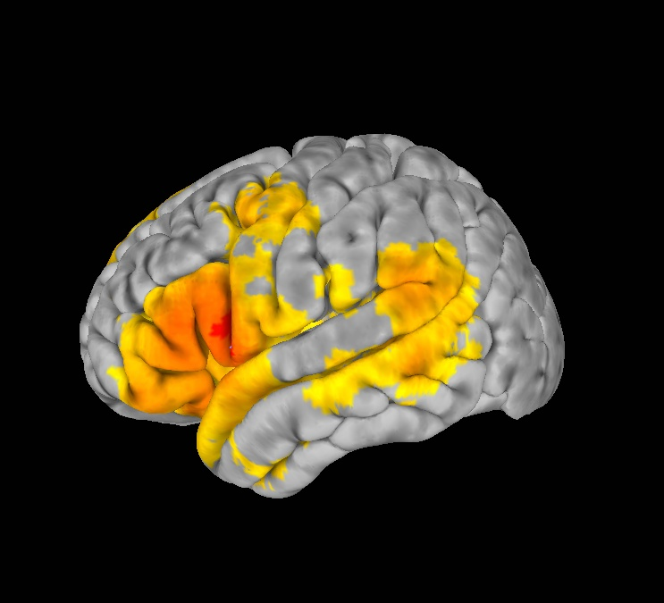
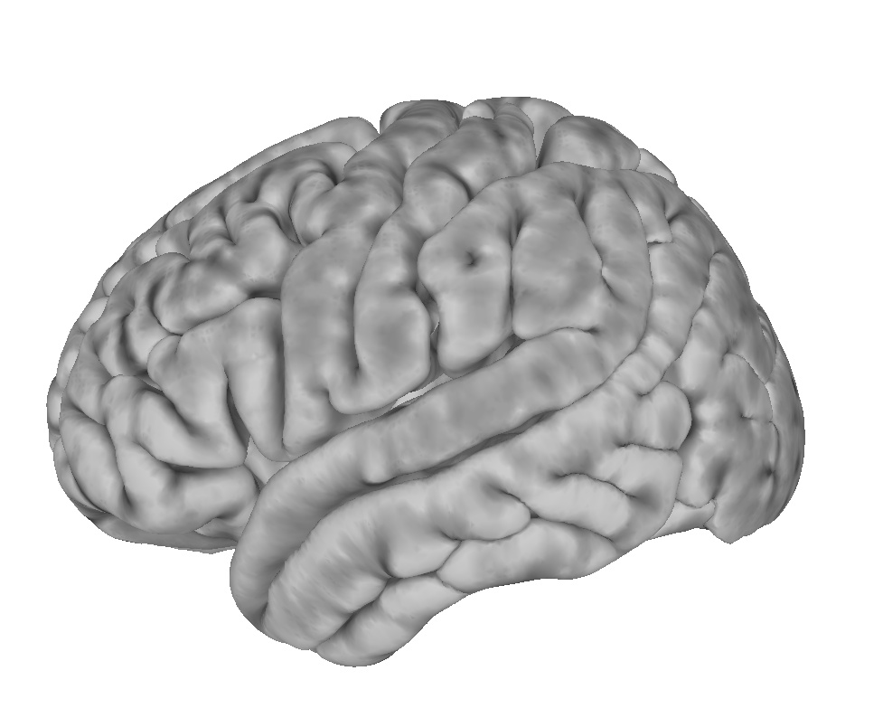
Computational Methodology
How do we detect organized patterns of intrinsic activity?
Resting State Functional Connectivity
Correlate
Notes:
How do we measure this organization?

Slide 17
Computational Methodology
Correlation
Zhang and Raichle, 2010. Nat Rev Neurol
17

Slide 18
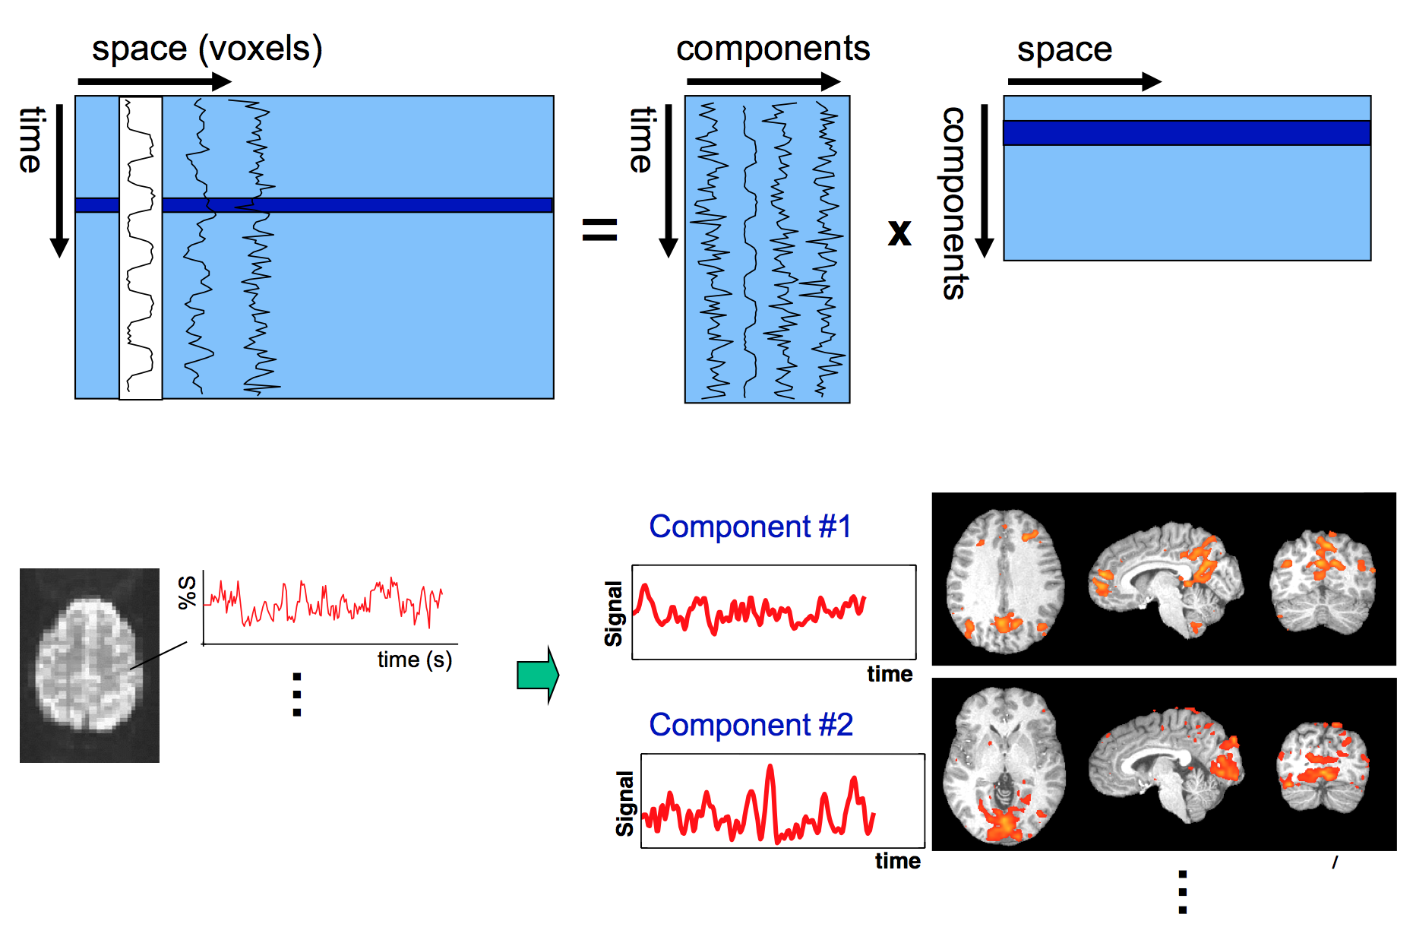
Computational Methodology
Independent Component Analysis
Birn
2015

Slide 19
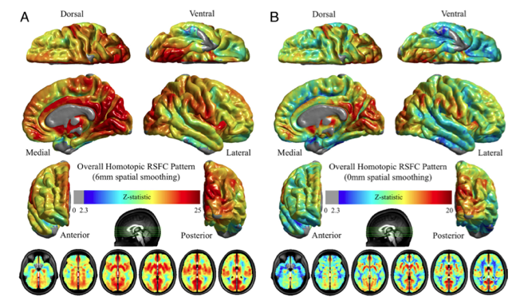
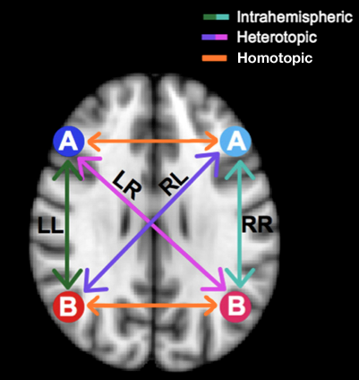
Computational Methodology
Voxel-mirrored homotopic connectivity (VMHC)
Gee et al., 2011
Zuo et al., 2010
19

Slide 20
Computational Methodology
Directionality
Association
(undirected network)
Directionality
Causality
(directed network)
20

Slide 21
Computational Methodology
Directionality
Statistical techniques
  Structural Equation Modeling (McIntosh and Gonzalez-Lima, 1994)
  Dynamic Causal Modeling (Friston et al., 2003)
  Granger Causality Analysis (GCA) (Granger, 1969; Goebel et al., 2003)
  ....
Lesion studies
Brain stimulation
Craddock, , Yan et al., 2013. Nat Methods

Slide 22
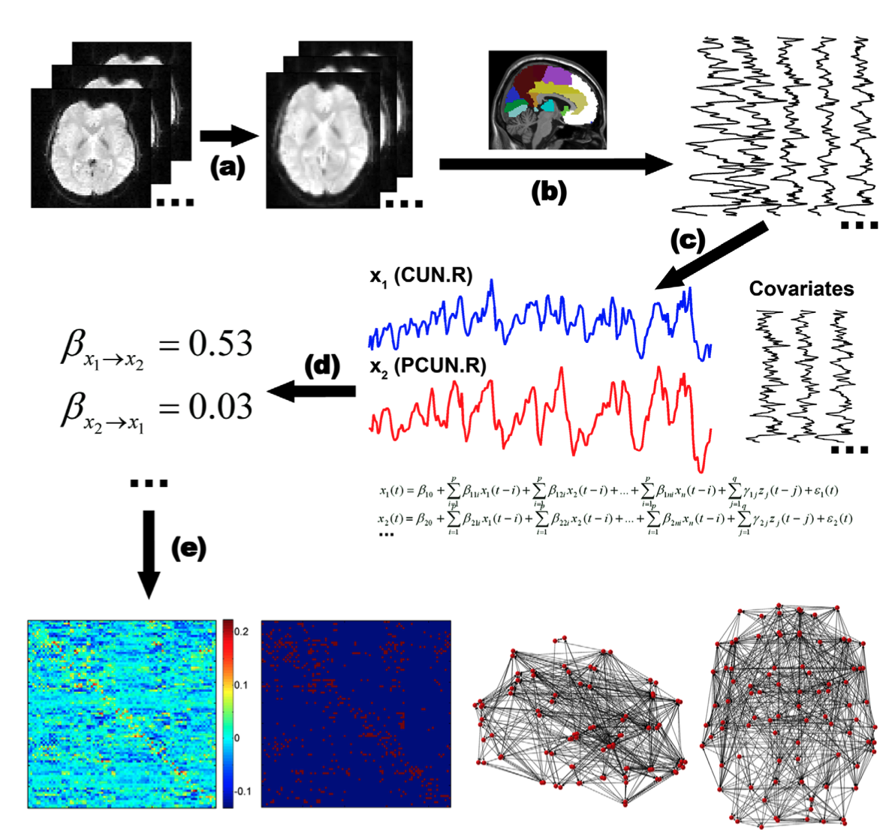
Computational Methodology
GCA in RS-fMRI
Yan et al., 2011.
PLoS ONE
22

Slide 23
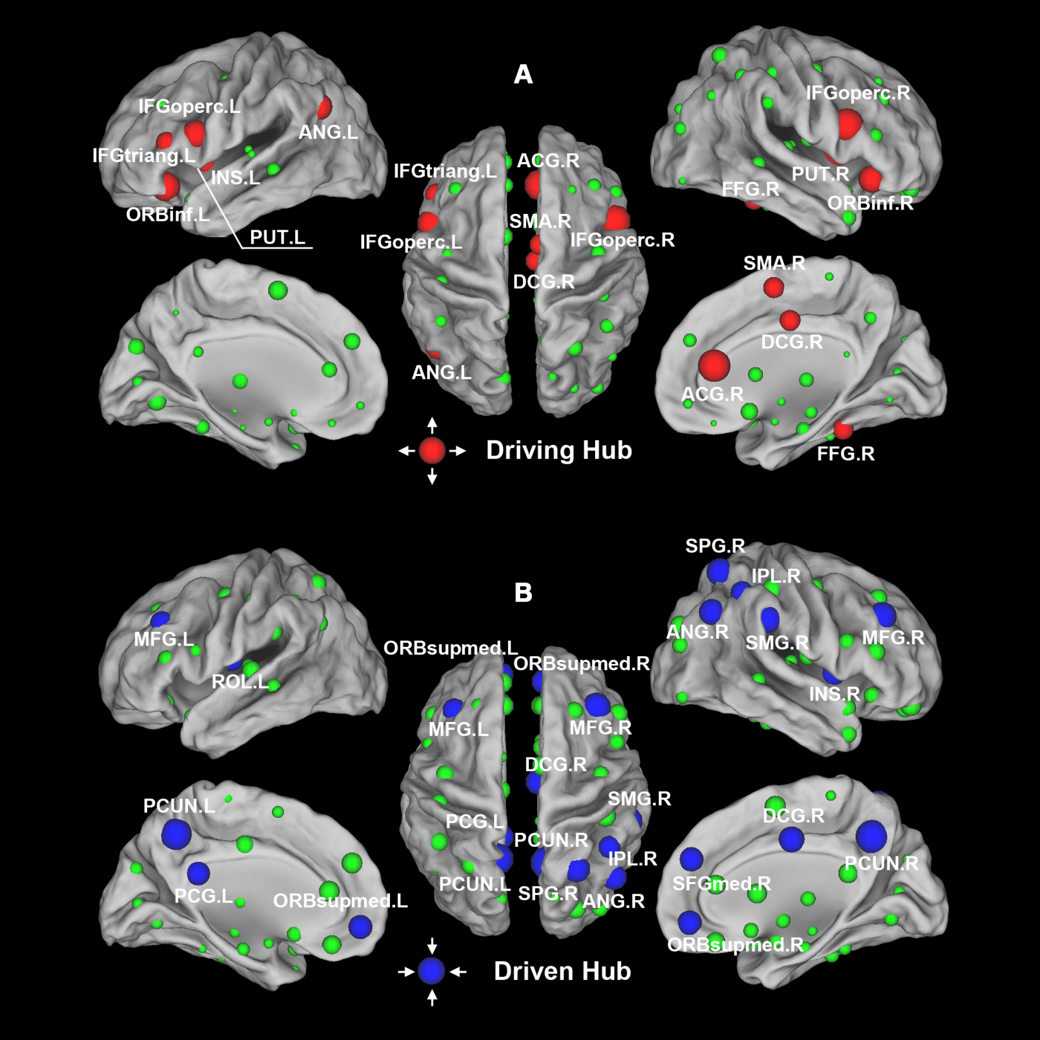
Computational Methodology
GCA in RS-fMRI
Yan et al., 2011.
PLoS ONE
23

Slide 24
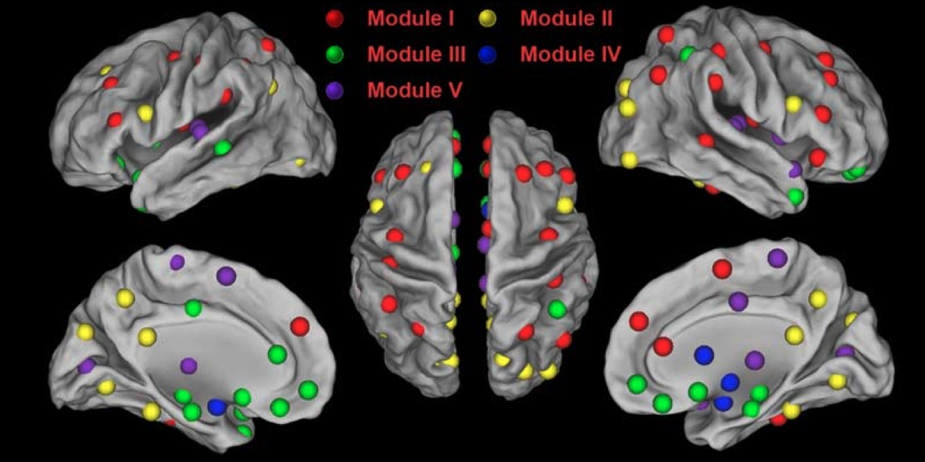
Computational Methodology
Yan et al., 2011.
PLoS ONE
24

Slide 25
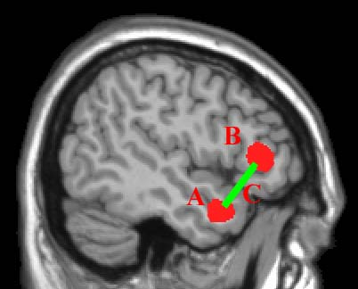
Computational Methodology
Regional approach
“Integrative” is really good, but:
Decreased
functional connectivity
Question: Is A, B, C, or……abnormal?

Slide 26
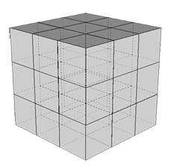
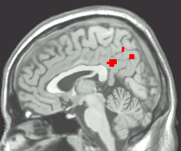
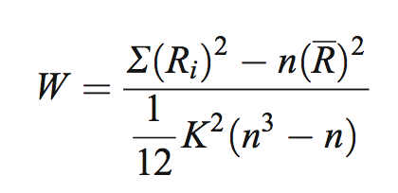
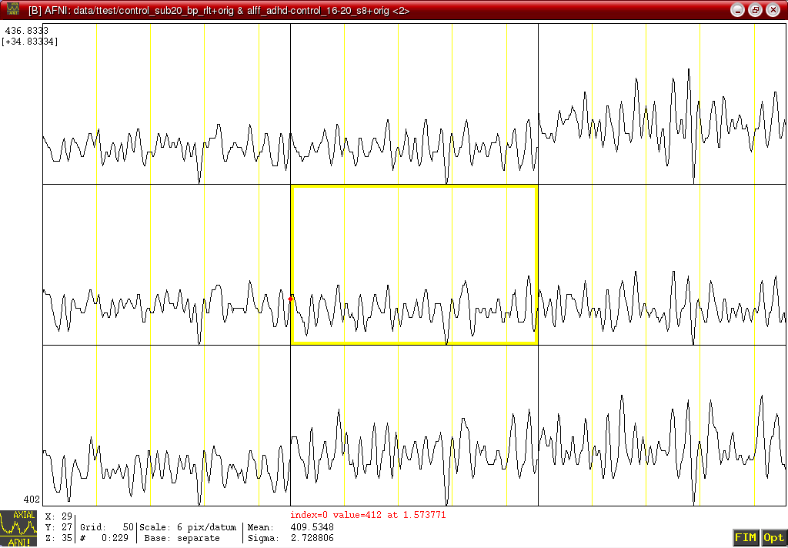
Regional Homogeneity (ReHo)
Computational Methodology
Similarity or coherence of the time courses within a functional cluster
(Zang et al., 2004)

Slide 27
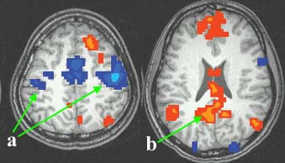
ReHo: motor task state vs. pure resting state
Computational Methodology
Rest > Motor
Motor > Rest
a) Higher ReHo in bilateral primary motor cortices during motor task
b) Higher ReHo in default mode network (PCC, MPFC, IPL) during rest (Raichle et al., 2001; Greicius et al., 2003)
(Zang et al., 2004)

Slide 28
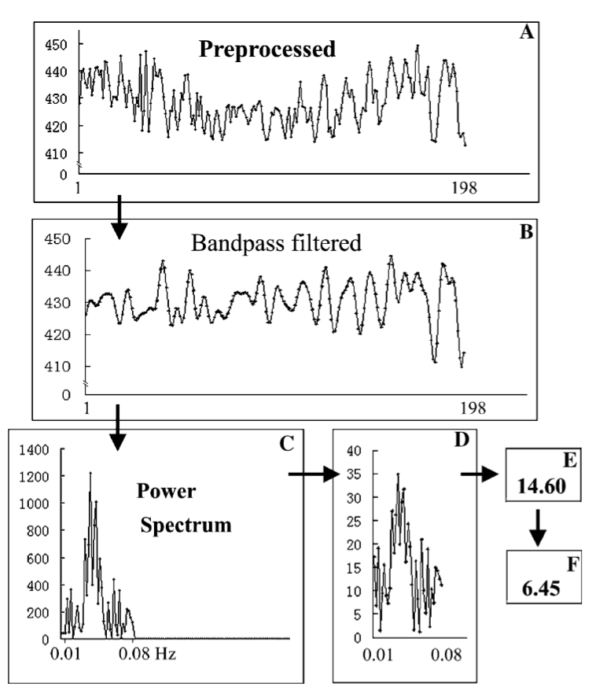
Amplitude of low frequency fluctuations
Zang et al., 2007
Notes:
How do we measure this organization?

Slide 29
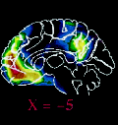
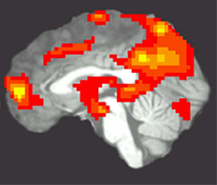
ALFF
Computational Methodology
PET
(Raichle et al., 2001)
ALFF
(Zang et al., 2007)
noise

Slide 30
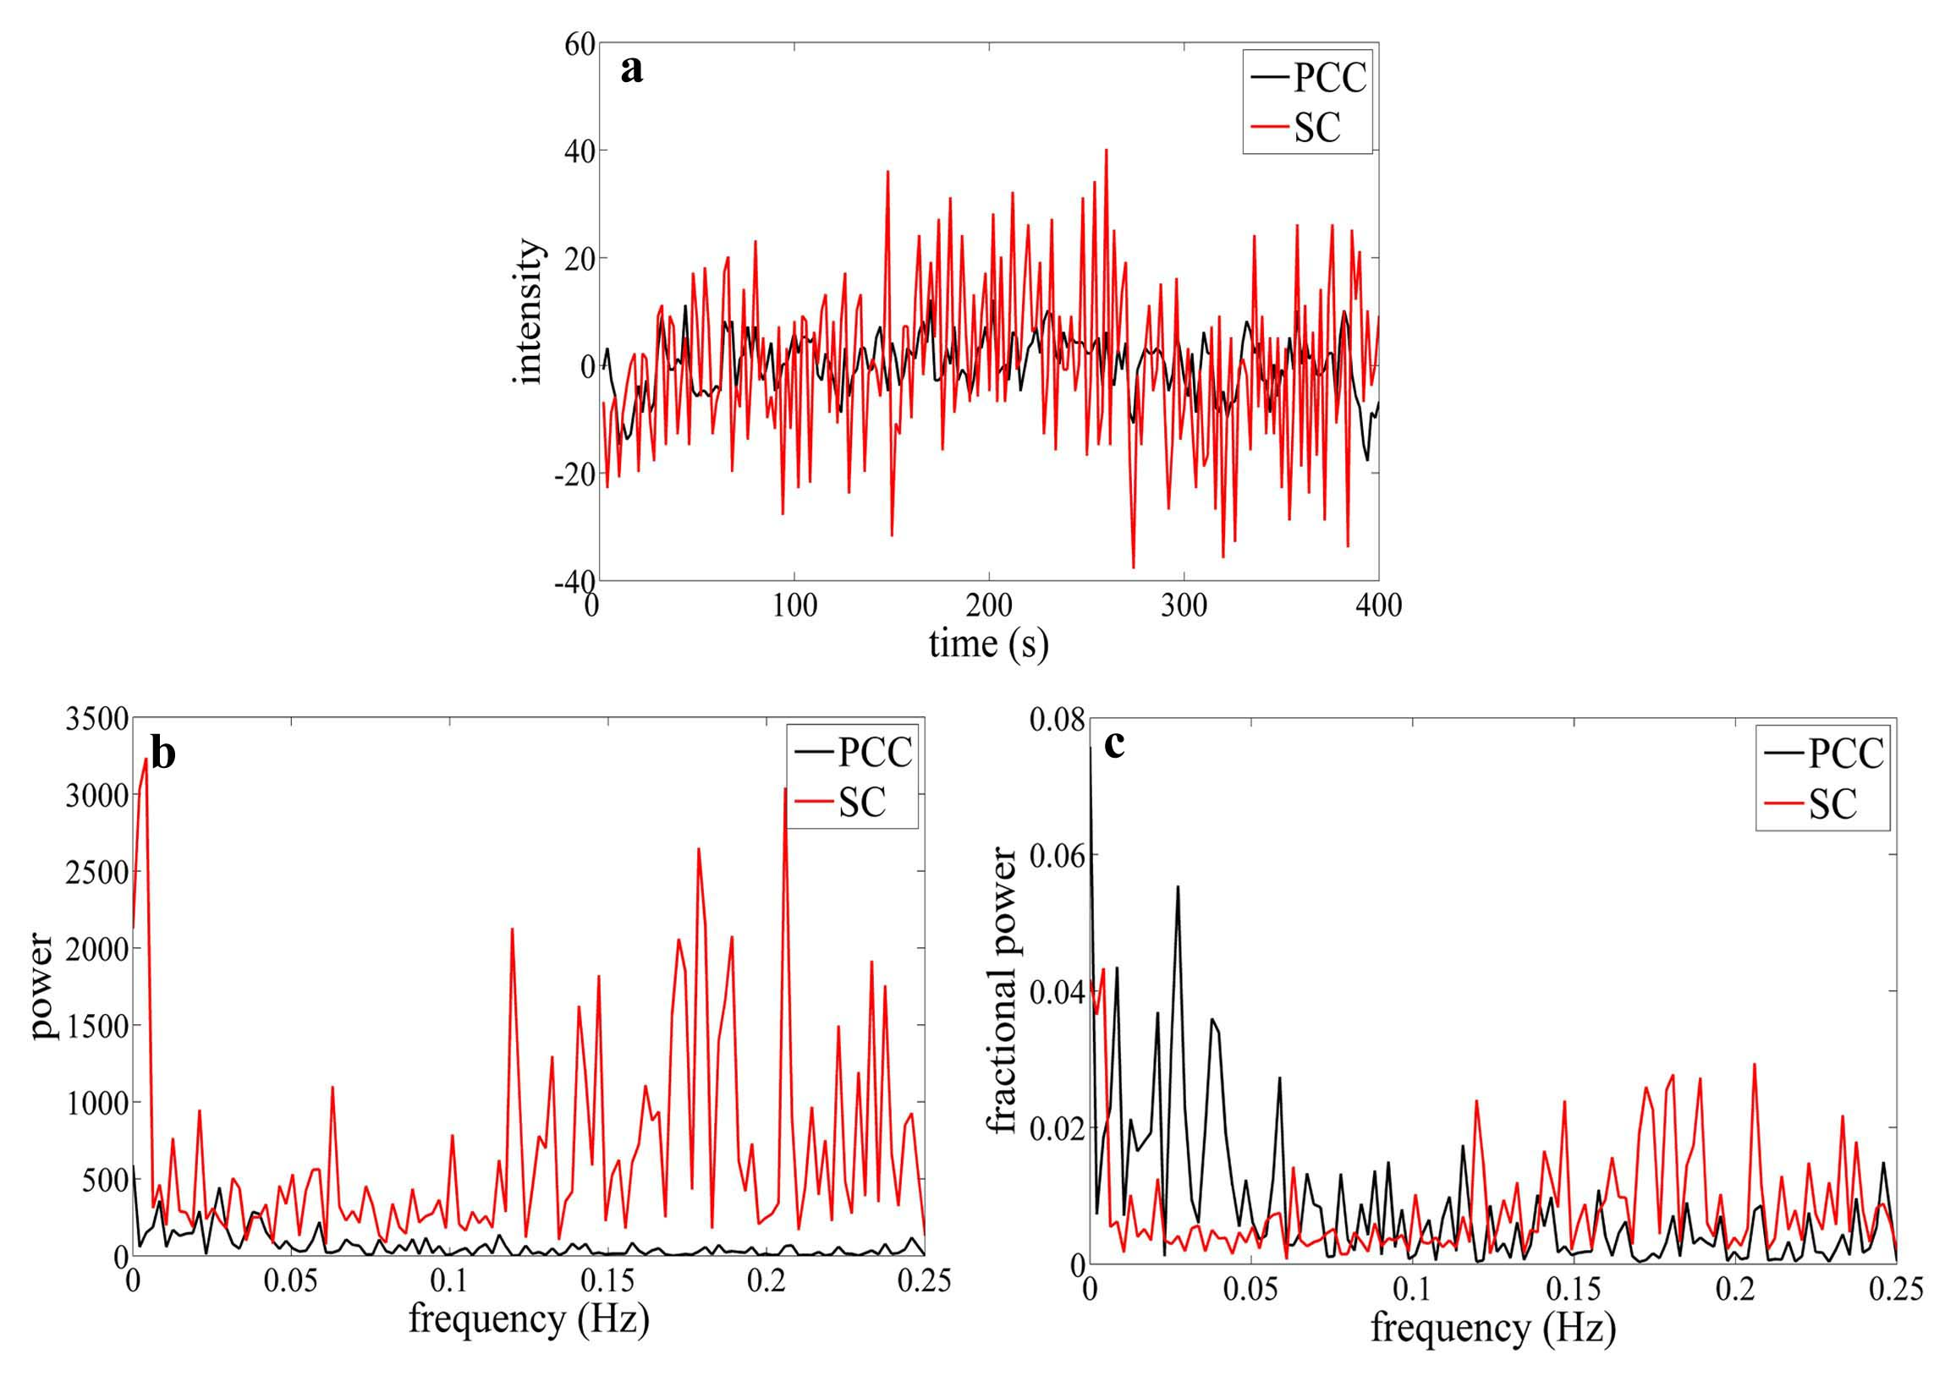


Improvement: fractional ALFF
Computational Methodology
Suprasellar cistern
PCC
Zou et al., 2008. J Neurosci Methods
Notes:
ADHD13例，正常对照儿童12例。静息态fMRI低频（0.01－0.08Hz）振幅（amplitude of low frequency fluctuation, ALFF）可能反映了自发脑活动的强度。SC:鞍上池

Slide 31
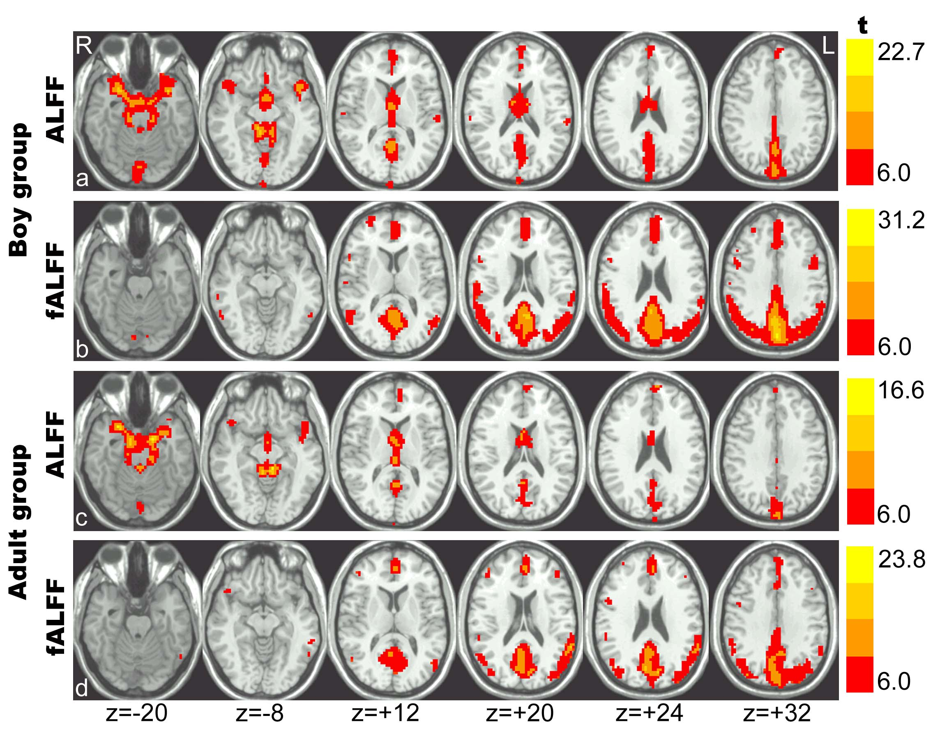
Improvement: fractional ALFF
Computational Methodology
Zou et al., 2008. J Neurosci Methods
Notes:
ADHD13例，正常对照儿童12例。静息态fMRI低频（0.01－0.08Hz）振幅（amplitude of low frequency fluctuation, ALFF）可能反映了自发脑活动的强度。SC:鞍上池

Slide 32
Computational Methodology
Graphical approach
Graph theoretical analysis: (Salvador et al., 2005, Bullmore and Sporns, 2009)
  Degree connectivity, functional connectivity density, degree centrality: (Buckner et al., 2009; Tomasi et al., 2010; Cole et al., 2010; Zuo et al., 2012)
…

Slide 33
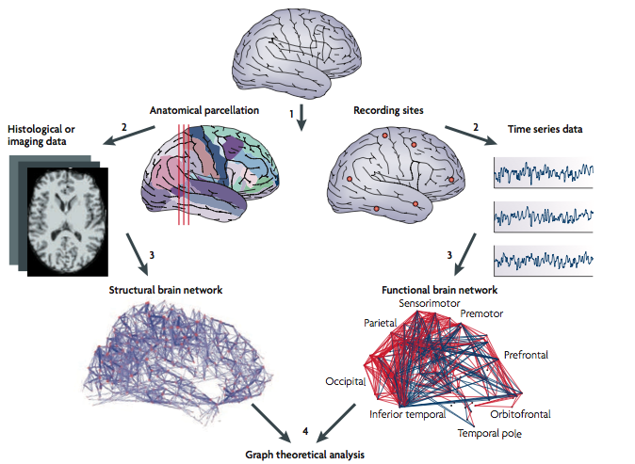
Computational Methodology
Graph theoretical analysis
Bullmore and Sporns, 2009

Slide 34
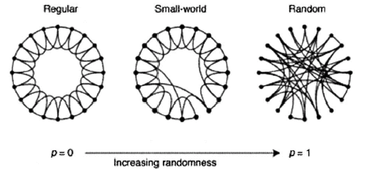
Computational Methodology
Graph theoretical analysis
Node: brain region
Link: connection
Watts and Strogatz, 1998. Nature
Regular:
high Cp
high Lp
Small-world:
high Cp
low Lp
Random:
low Cp
low Lp
Small-world networks contain many local links and a few long-distance links (so-called “shortcuts”).
Cp: average clustering of a network
Lp: average shortest path length of a network
34

Slide 35
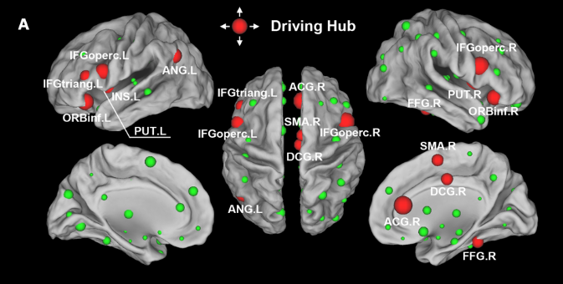
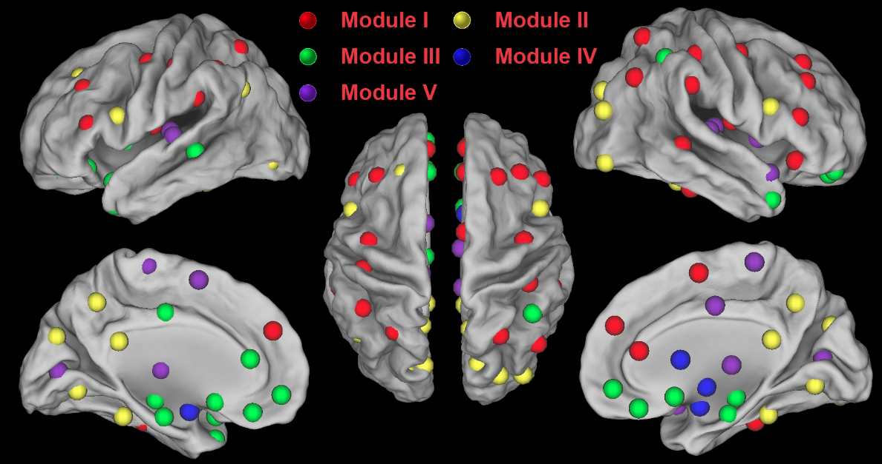
Computational Methodology
Graph theoretical analysis
Hub
Module
Yan et al., 2011. PLoS ONE

Slide 36
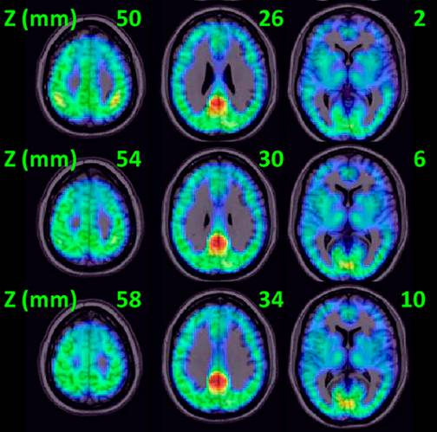
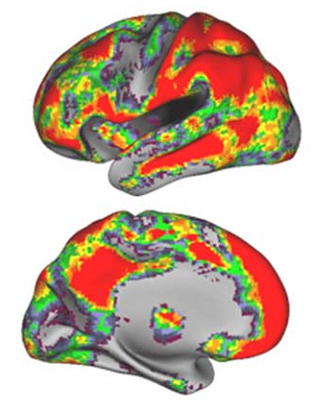
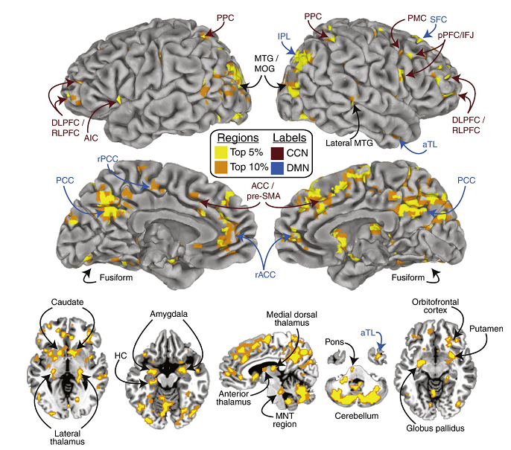
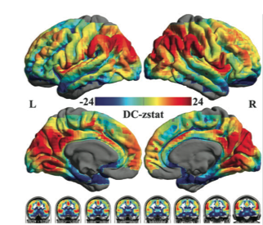
Computational Methodology
Degree centrality
Buckner et al., 2009. J Neurosci
Tomasi et al., 2010. PNAS
Cole et al., 2010. Neuroimage
Zuo et al., 2011. Cereb Cortex

Slide 37
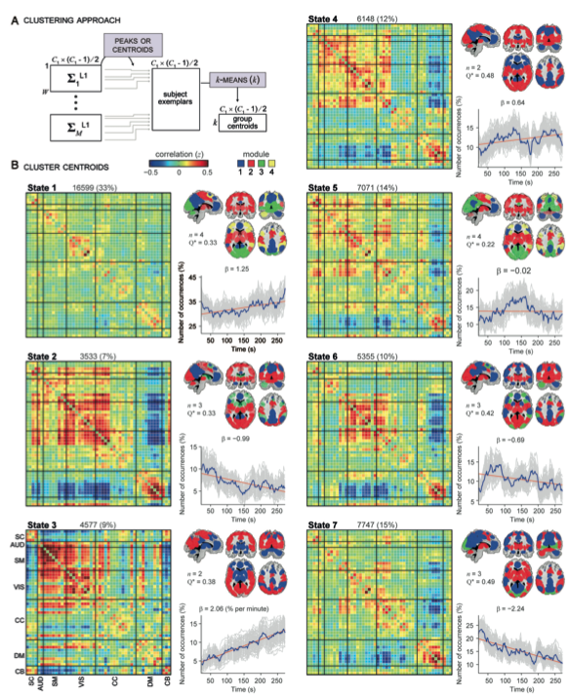
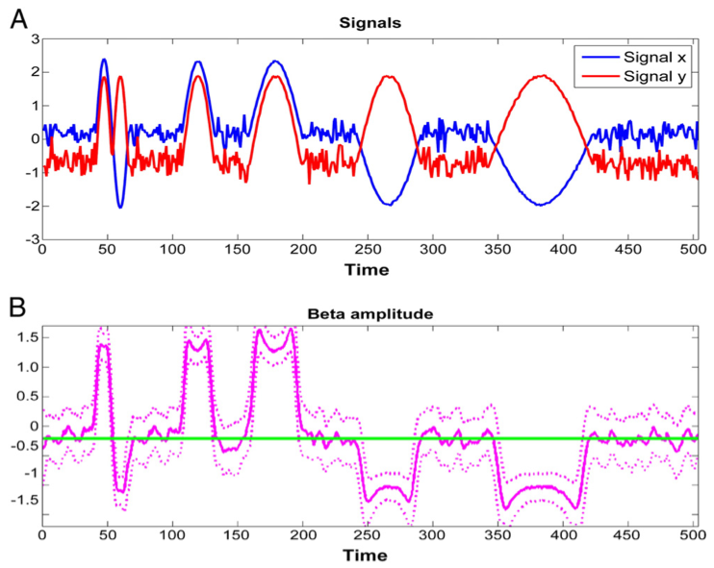
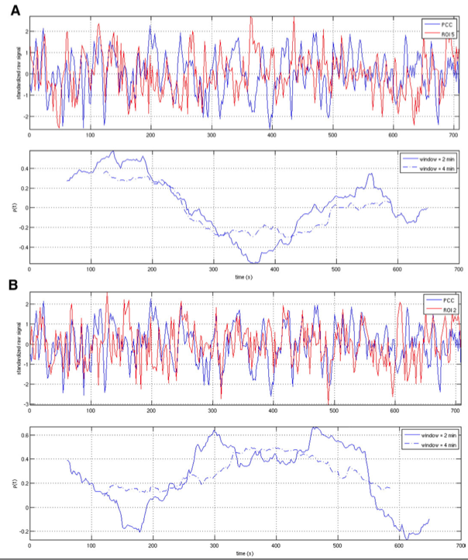
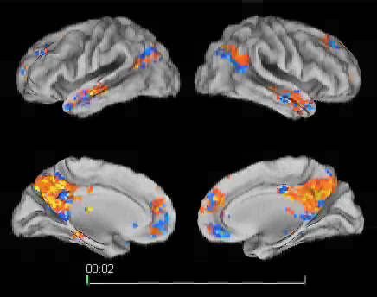
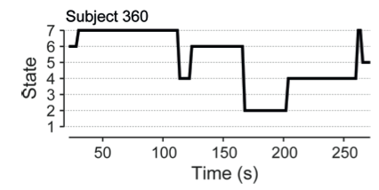
Computational Methodology
Dynamic perspective
Chang and Glover, 2010.
Neuroimage
Kang, , Yan et al., 2011.
Neuroimage
Allen et al., 2013.
Cereb Cortex

Slide 38
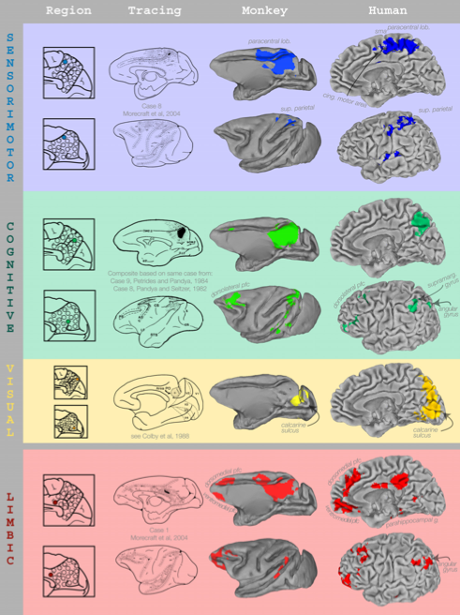
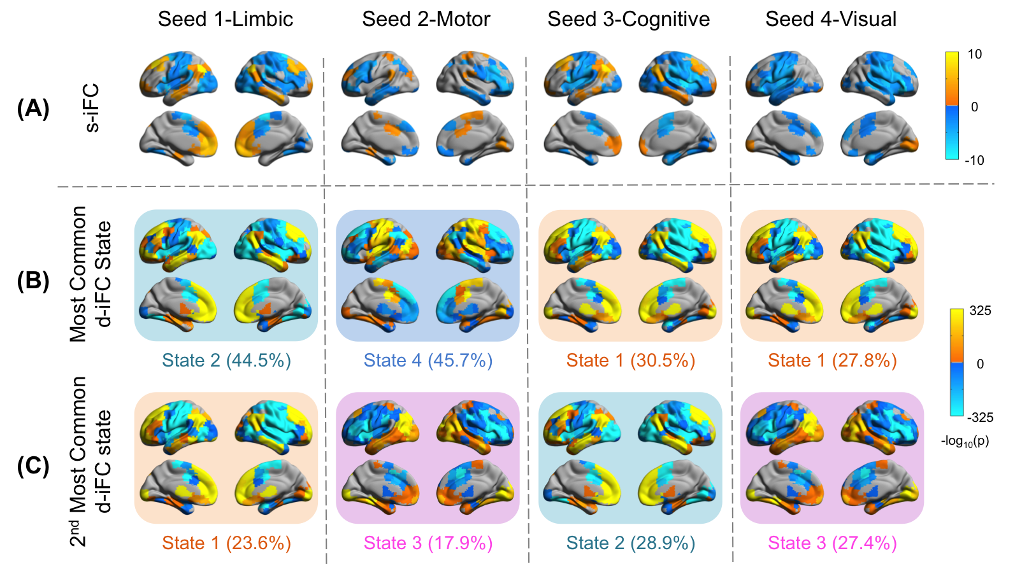
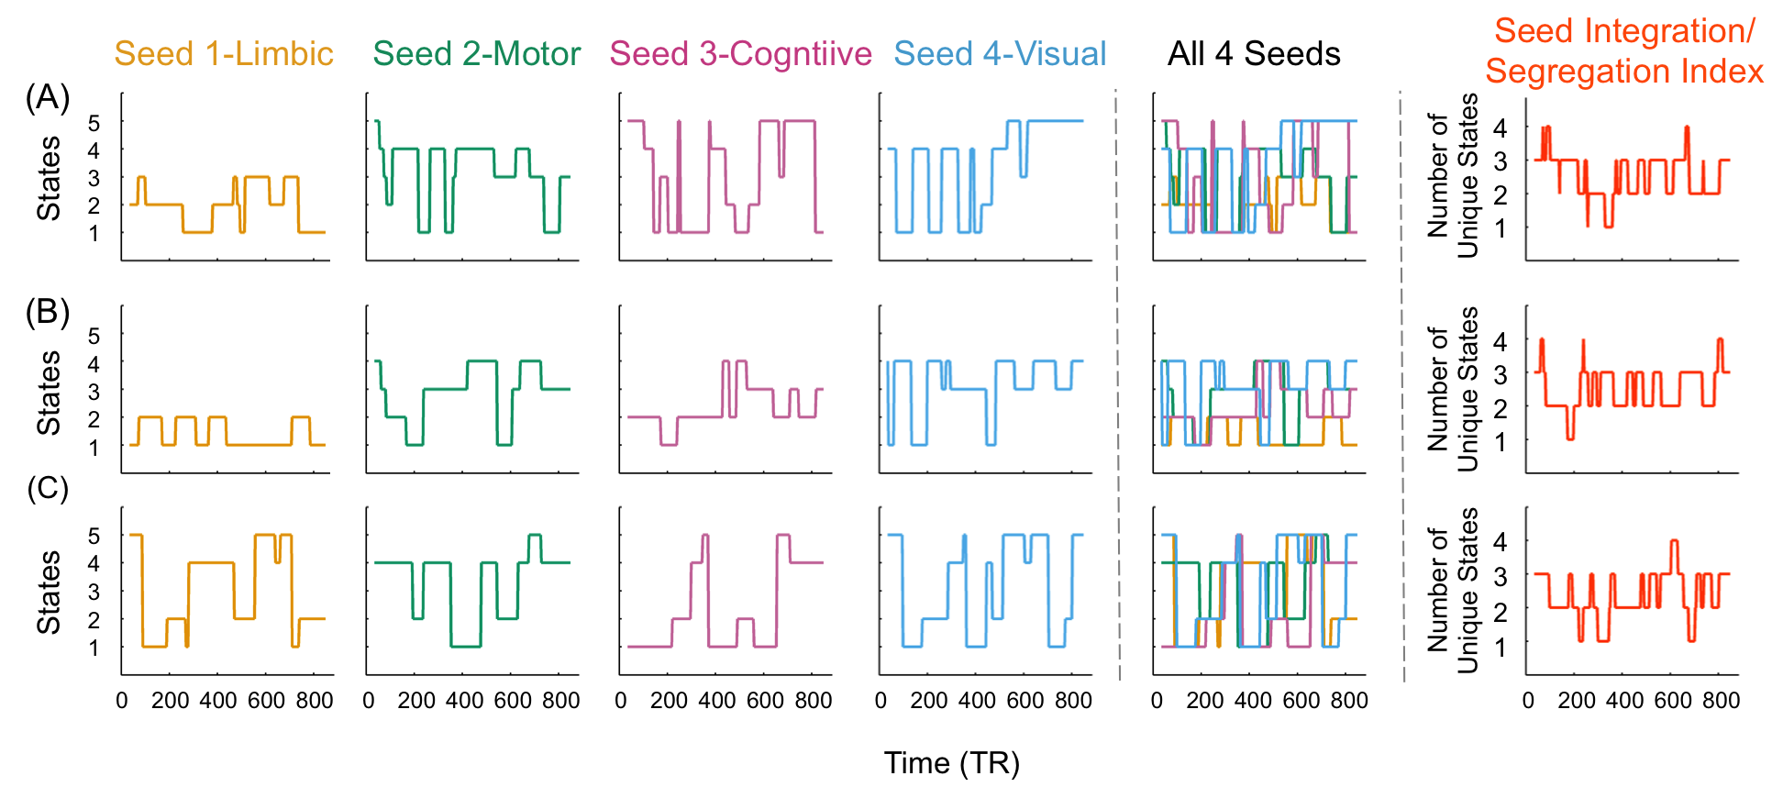
Computational Methodology
Dynamic perspective
Margulies et al., 2009. PNAS
Yang, , Yan, Milham, 2014. Neuroimage

Slide 39





A Growing Range of R-fMRI Indices for Intrinsic Brain Function
Voxel strength: ALFF/fALFF
Regional synchronization: ReHo
Homotopic connectivity: VMHC
Global connectivity: Degree Centrality
Global Signal Correlation

Slide 40



Concordance Among Indices of Intrinsic Brain Function
Yan et al., in prep.

Slide 41
Outline
Resting-State fMRI: Principles
Data Analysis: Computational Algorithms
Data Analysis: Methodological Issues
Data Analysis: Computational Platform
41

Slide 42
Methodological Issues
Experiment settings
Head motion
Standardization
Multiple-comparison correction
And many many more…
Yan et al., 2009. PLoS ONE;
Wang, , Yan et al., 2012. PLoS ONE
Yan et al., 2013a. Neuroimage
Yan et al., 2013. Front Hum Neurosci
Yan et al., 2013b. Neuroimage
Chen & Yan, in prep.

Slide 43

Different resting conditions?
Methodological Issues
The functional connectivity patterns of the default mode network was minimally disturbed during different resting conditions with limited cognitive demand (Greicius et al., 2003; Fransson, 2005; Fox et al., 2005)
Fox et al., 2005. PNAS

Slide 44


Different resting conditions?
Methodological Issues
Regional activity (ALFF) within DMN
Functional connectivity within DMN
Yan et al., 2009. PLoS ONE

Slide 45


Different resting conditions?
Methodological Issues
Van Dijk et al., 2010. J Neurophysiol
Patriat et al., 2013. Neuroimage

Slide 46
Methodological Issues
Experiment settings
Make resting-state condition consistent: e.g., fixation (depends on the cooperation of participants).
Make resting-state session before task sessions, unless intended.

Slide 47



Head motion matters
Methodological Issues
Van Dijk et al, 2012. Neuroimage
Power et al, 2012. Neuroimage
Satterthwaite et al., 2012. Neuroimage

Slide 48

Methodological Issues
Yan et al., 2013a. Neuroimage

Slide 49

Methodological Issues
Yan et al., 2013a. Neuroimage

Slide 50

Yan et al., 2013a. Neuroimage

Slide 51

Methodological Issues
Yan et al., 2013a. Neuroimage
Cited: > 400 times

Slide 52




Times Cited: >400 (Google Scholar)

Slide 53



Standardization
Methodological Issues
Yan et al., 2013b. Neuroimage

Slide 54
Standardization
Yan et al., 2013b. Neuroimage

Slide 55

The Impact of Standardization Procedures on Confound Variables: Site Effects
55
Notes:
Two Subjects
C: Scrubbed - unscrubbed

Slide 56

The Impact of Standardization Procedures on Confound Variables: Motion Effects
56
Notes:
Two Subjects
C: Scrubbed - unscrubbed

Slide 57

The Impact of Standardization Procedures on Variables of Interest: Age Effects
57
Notes:
Two Subjects
C: Scrubbed - unscrubbed

Slide 58
Methodological Issues
Standardization
Mean regression-based approach.
Mean regression + SD division (for controlling mulplicative effects).

Slide 59


Standardization
Methodological Issues
Collaborate with Dr. Xi-Nian Zuo @ IPCAS
Dr. Jia-Hong Gao @ PKU
National Natural Science Foundation of China (81671774) (PI: Yan)
Beijing Municipal Science & Technology Commission (Z161100000216152) (PI: Gao)
National Basic Research (973) Program (2015CB351702) (Co-I: Zuo)

Slide 60



R-fMRI: Methodological Issues
Eklund et al., 2016. PNAS
60
Notes:
Two Subjects
C: Scrubbed - unscrubbed

Slide 61

Sensitivity (Power) in Small Sample
Chen, Lu, Yan*, in prep.
15 M vs. 15 F × 10 times
61
Notes:
Two Subjects
C: Scrubbed - unscrubbed

Slide 62
Positive Predictive Value in Small Sample
Chen, Lu, Yan*, in prep.
15 M vs. 15 F × 10 times
62
Notes:
Two Subjects
C: Scrubbed - unscrubbed

Slide 63

The R-fMRI Maps Project
63

Slide 64
Outline
Resting-State fMRI: Principles
Data Analysis: Computational Algorithms
Data Analysis: Methodological Issues
Data Analysis: Computational Platform
64

Slide 65



Neuroinformatics Platform
http://rfmri.org/dpabi
Yan et al., 2016. Neuroinformatics

Slide 66

Neuroinformatics Platform
Advanced DPARSF
Head motion control (Yan et al., 2013a)
Standardization (Yan et al., 2013b)
Permutation test
...
Yan and Zang, 2010. Front Syst Neurosci.
Cited: > 900 times

Slide 67


DPARSF

Slide 68
Data Organization
ProcessingDemoData.zip
  FunRaw
    Sub_001
    Sub_002
    Sub_003
  T1Raw
    Sub_001
    Sub_002
    Sub_003
Functional DICOM data
Structural DICOM data

Slide 69


Resting State fMRI Data Processing
Template Parameters
69

Slide 70

70

Slide 71


Slide 72

Quality Control
72

Slide 73
Quality Control
73

Slide 74

Quality Control
74

Slide 76


Statistical Analysis
76

Slide 77


77

Slide 79


Slide 80


Slide 81

81

Slide 82

Further Help
Further questions:
http://rfmri.org/dpabi
The R-fMRI Network
82

Slide 83

Further Help
http://rfmri.org/Course
83

Slide 84


84

Slide 85

85

Slide 86





http://rnet.pw/jc
搜索公众号：RFMRILab
http://douyu.com/rfmri
86

Slide 87

The R-fMRI Lab
WeChat Official Account: RFMRILab
87

Slide 88
Acknowledgments
Chinese Academy of Sciences Xi-Nian Zuo
NYU Child Study Center
F. Xavier Castellanos
Hangzhou Normal University Yu-Feng Zang
Child Mind Institute
Michael P. Milham
Beijing Normal University
Yong He
Xin-Di Wang
Peking University
Jia-Hong Gao
Wei-Wei Men
Funding
National Natural Science Foundation of China
Chinese Academy of Sciences
Notes:
Different Axis!!!

Slide 89
Thanks for your attention!
89

